Slide 1



Using Domestic Materials in Utility Relocations

Slide 2
When Domestic Materials are of concern
When non-domestic is acceptable
Project steps
Compliance review

Slide 3
When Domestic Materials are of concern
Permanently Installed Utility Infrastructure
Eligible for Project Reimbursement
Must use domestic infrastructure if:
Project uses Federal funding in any phase
BA/BABA bucket items

Slide 4


Reimbursement Eligibility
KRS 177.035
KRS 179.265
Municipalities, water, sewer, school districts shall be reimbursed
Utilities on other than public row shall be reimbursed
Other utilities may be reimbursed*
Reimbursement Agreements
Subject to BA/BABA
No Charge Agreements
Not subject to BA/BABA if ineligible

Slide 5


The buckets:
Steel and Iron
Manufactured Products
Construction Materials

Slide 6

BA
BABA
Domestic Material

Slide 7
Buy America (BA)
Build America Buy America (BABA)
Iron and steel
Expands stricter domestic content rules to all federally funded infrastructure projects.
Added construction materials
Manufactured products

Slide 8
Steel and Iron
Articles, materials, or supplies that consist of the following:
Wholly/predominantly iron or steel or
Combination of both
Cost of the iron and steel content >50% the total cost of all its components

Slide 9
Manufactured Products
Articles, materials, or supplies processed into a specific form and shape.
Combined with other articles, materials, or supplies
Create a product with different properties than the individual articles, materials, or supplies.
Arrives to job in final form.
55% of component costs must be U.S. produced.

Slide 10
Construction Materials
Articles, materials, or supplies that consist of one of the following:
Non-Ferrous metals
Plastic and polymer-based products
Glass
Fiber optic cable
Optical Fiber
Lumber
Engineered wood or drywall

Slide 11
Notes
Minor additions
Adding articles, materials, supplies, or binding agents to a construction material, does not change the categorization.
Does not include
Section 70917(c) Excluded Materials
Cement and cementitious materials.
Aggregates such as stone, sand, or gravel.
Aggregate binding agents or additives.

Slide 12
Project steps
Validate with specific documents and actions
Address domestic material use at milestones

Slide 13
Domestic Material Compliance Milestones
*Binding terms via agreement.
Verify compliance with field inspections.
*Owner certification via invoice.
Communicate outcomes in utility and rail impact note.
Conduct compliance reviews
*Notification with a state letter.
Coordinate with Utility during plan development.
* Indicates the milestone is explicitly included in templated documentation
Bold text will be discussed further in this presentation

Slide 14


Coordinate with Utility during plan development.
Review plans and estimate
Ask the utility about non-domestic materials and certification retainage
Provide the Domestic Materials Self Certification Form
Identify Non-Domestic needs (quantities, costs & justification)

Slide 15
ID Non-Domestic needs at least 9 months before letting

Slide 16
Domestic Materials Self-Certification Form
Product, Quantity and Project specific
Already adopted by Division of Construction
Starting July 1, 2026
Certifications must be retained by the utility and produced upon request.

Slide 17

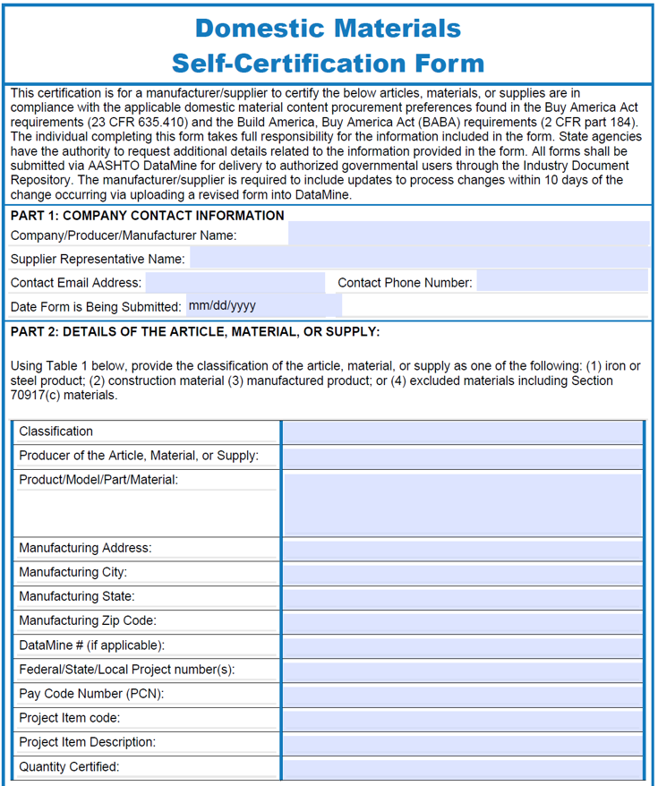

Slide 18
Violations can result in:
1. Contract termination
2. Debarment from future federal contracts
3. False claims liability

Slide 19
Domestic Material Compliance Milestones
*Binding terms via agreement.
Verify compliance with field inspections.
*Owner certification via invoice.
Communicate outcomes in utility and rail impact note.
Conduct compliance reviews
*Notification with a state letter.
Coordinate with Utility during plan development.
* Indicates the milestone is explicitly included in templated documentation
Bold text will be discussed further in this presentation

Slide 20
Verify compliance with field inspections.
When utility company relocation begins
KYTC must provide inspections
Monitor utility materials delivered and permanently incorporated for compliance

Slide 21
Review jobsite for compliance including minimal use or waivers.
If non-compliant stop contractor from using material.
Take additional steps to remove non-domestic, secure domestic, and/or address the matter.

Slide 22
Domestic Material Compliance Milestones
*Binding terms via agreement.
Verify compliance with field inspections.
*Owner certification via invoice.
Communicate outcomes in utility and rail impact note.
Conduct compliance reviews
*Notification with a state letter.
Coordinate with Utility during plan development.
* Indicates the milestone is explicitly included in templated documentation
Bold text will be discussed further in this presentation

Slide 23
Communicate outcomes in utility and rail impact note.
If a utility must use any non-domestic items they must be accepted by both the project team and FHWA
Must document via clause in the utility and rail certification note.
This clause will document the non-domestic items and category, cost, and other items.

Slide 24
Domestic Material Compliance Milestones
*Binding terms via agreement.
Verify compliance with field inspections.
*Owner certification via invoice.
Communicate outcomes in utility and rail impact note.
Conduct compliance reviews
*Notification with a state letter.
Coordinate with Utility during plan development.
* Indicates the milestone is explicitly included in templated documentation
Bold text will be discussed further in this presentation

Slide 25
Conduct compliance reviews
Division of Right of Way and Utilities will conduct sample compliance reviews
On demand reviews may also be requested if non-compliance is suspected
At end of each fiscal year

Slide 26
When non-domestic is acceptable
Adheres to a project's minimum threshold
Secure a Project Waiver
Find a National Waiver

Slide 27
Steel/Iron Minimal Use
23 CFR 635.410(b)(4)
$2,500 of iron and steel products as delivered to the project
0.1% of the total contract amount

Slide 28
CM/MP Minimal Use
Section 70914(b)(1)
Total value of non-compliant products <= $1,000,000 or 5% of total allowable costs under the Federal financial assistance award.
Federal financial assistance award < $500,000; or
Non-domestically produced miscellaneous minor components < 5% of the total material cost

Slide 29
Non-compliant value
Minimal Use
Applicable project costs
Non-compliant manufactured products + construction materials for the entire project
All steel, iron, manufactured products, and construction materials

Slide 30
Non-domestic MP and CM minimal use applies to the entire Federal financial assistance award.

Slide 31
Minimal Use Process
Minimal use
Utility supervisor verifies the item qualifies
Document the quantity, cost, and justification of need
Area utility coordinator verifies
Secure project team and FHWA acceptance
Track usage during utility construction
Record in the Utility and Rail Impact Note for bidding contractors

Slide 32
Waivers
Allow a minimum of 9 months to consider a project waiver
No guarantee of success so seek waivers far before the project letting
No known national waivers exist for utility work

Slide 33
Waivers
Reasons for Project Waiver
Item is not domestically produced in sufficient, reasonable quantities or of satisfactory quality
Domestic item increases the overall project cost by >25%
Domestic item is not in the public interest

Slide 34
Waiver Process
Request for waiver posted for public comment.
Address comments (Iterative)
MIAO makes a determination
Develop Request for Waiver report by US, AC, and the utility owner
Project team and project development branch manager review
Division review
SHE office review
FHWA division office review
FHWA HQ and Made in America Office (MIAO) review

Slide 35
Compliance review
FIRST FISCAL YEAR REVIEW
DATA COLLECTION
SAMPLE
REVIEW
ASSESS & RESOLVE
Run a report through KURTS of all invoices paid in the previous FY.
Randomly select 10 invoices with materials charges.
Verify applicable KYTC BA and BABA requirements are met.
Notify utility companies of discrepancies
Opportunity to provide additional information
Resolve disputes
Confirm the domestic material requirements clause was included in the binding agreement and signed by the utility owner
Utility company signed and confirmed domestic material compliance on all selected invoices

Slide 36
SECOND FISCAL YEAR REVIEW
DATA COLLECTION
Run a report through KURTS of all invoices paid in the previous FY.
SAMPLE
Randomly select 10 invoices with materials charges.
REVIEW
Verify applicable KYTC BA and BABA requirements are met.
Select one BA/BABA applicable material from each selected invoice and request the manufacturer certification for that material.
ASSESS & RESOLVE
Notify utility companies of discrepancies
Opportunity to provide additional information
Resolve disputes

Slide 37
Next steps
Policy adopted
Monitor quarterly
FY2027 compliance review
FY2026 compliance review
Outreach
Questions?

